Slide 1
Welcome to 5B
Meet the Teacher

Slide 2
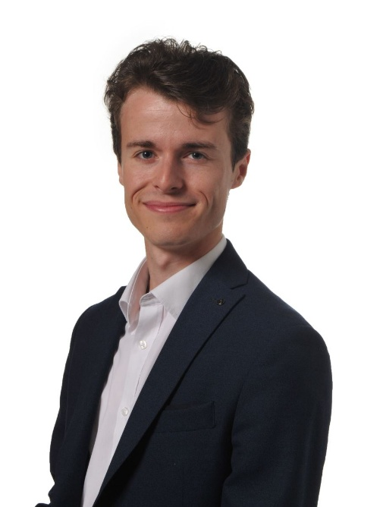
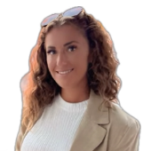
Staff working with 5B
Miss Bunce
Mr Young

Slide 3

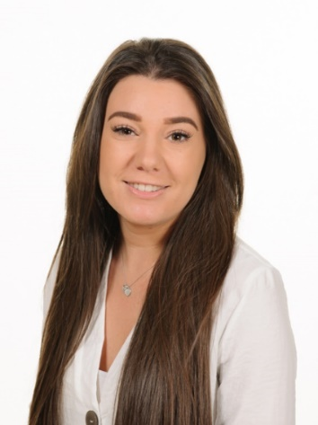
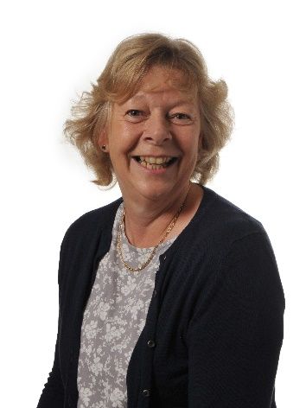
Safeguarding Team
Mr Rooney – Designated Safeguarding Lead (DSL)
Miss Quinby – Deputy DSL
Mrs West – Deputy DSL

Slide 4
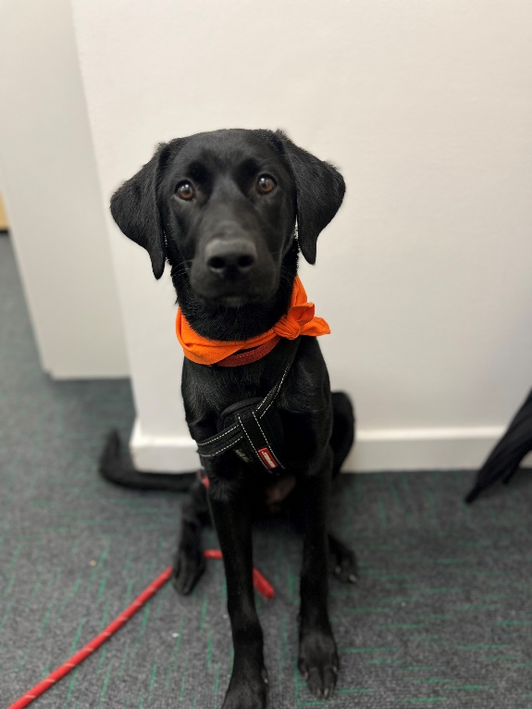
Dog Mentor
Rosie

Slide 5
Curriculum Areas
Language, Oracy and Literacy
Mathematics
Science and Technology
Place and Time
Arts and Creativity
Physical and Emotional Health
Ethics and Citizenship
Faith and Belief

Slide 6
P4C
An enquiry based approach to open up children’s learning through the exploration of ideas.
Gives children the possibility of seeing that their ideas have value, and that others have different ideas that have value too.
They realise that they don’t always have to be right.
They have the confidence to ask questions and learn through discussion.
A chance to speak and be heard without fear of getting an answer wrong.
Gives the children a chance to think outside the box and to see that the non-academic have inspiring ideas.

Slide 7
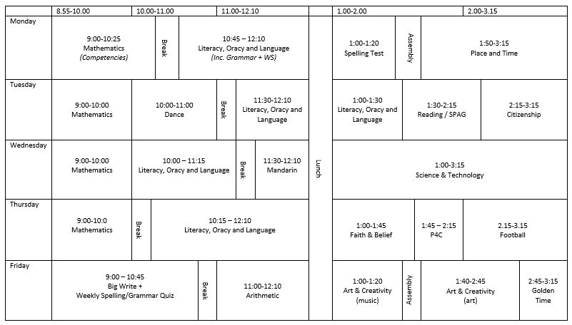

Slide 8
PE
The class will have two PE lessons per week.
This term, P.E. will take place on Wednesday and Thursday.
Children should come into school in their kit.
Wednesday is the new navy Lowbrook PE kit, available from Goyals.
Thursday is blacks – plain black t-shirt and plain black shorts.
In winter months, children may wear either the new Lowbook hoody or their school jumper/cardigan. They may also wear plain navy joggers or skins if they wish.
Trainers should be in school everyday.

Slide 9
Rewards and Sanctions
Rewards:
Sanctions
Positive praise
Team points
Stickers
Sent to SLT
Verbal warning
Minutes off break/Golden Time
Sent to SLT and note/call home

Slide 10
Homework
Homework will always reflect what we are working on in class.
Homework will be set on Google classroom and is expected to be completed on time:
Set on Friday
Reading Comprehension (paper copy due in Monday).
MagmaMaths (due in for the following Friday).
Set Daily
Reading
Spelling revision (to be tested every Monday at minimum).
Competency revision (to be tested every Monday).
Some will have daily times tables on Purple Mash and will need to screen shot their results to post on Google Classroom.
AdHoc
SPaG (reflecting either the spelling or SPaG rule we have been working on)
Notes:
Spelling stars are made up of the 109 HFW list of 5/6 words.
Weekly spellings are spelling rules / patterns

Slide 11
Homework
All children should read at home every night and should have their reading records signed daily by an adult at home. These will be checked every day by myself or Mr Young.
Please ensure your child is reading a variety of different texts and genres. Accelerated reader quizzes are to be completed once a book is finished.
It is expected that homework is always completed and handed in on time (except in special circumstances).
If homework is not completed by the due date, children may be asked to stay in for part of their lunch break and complete some or all of it with me.
If children are having difficulties with homework, we will be more than happy to go over it again with them.

Slide 12
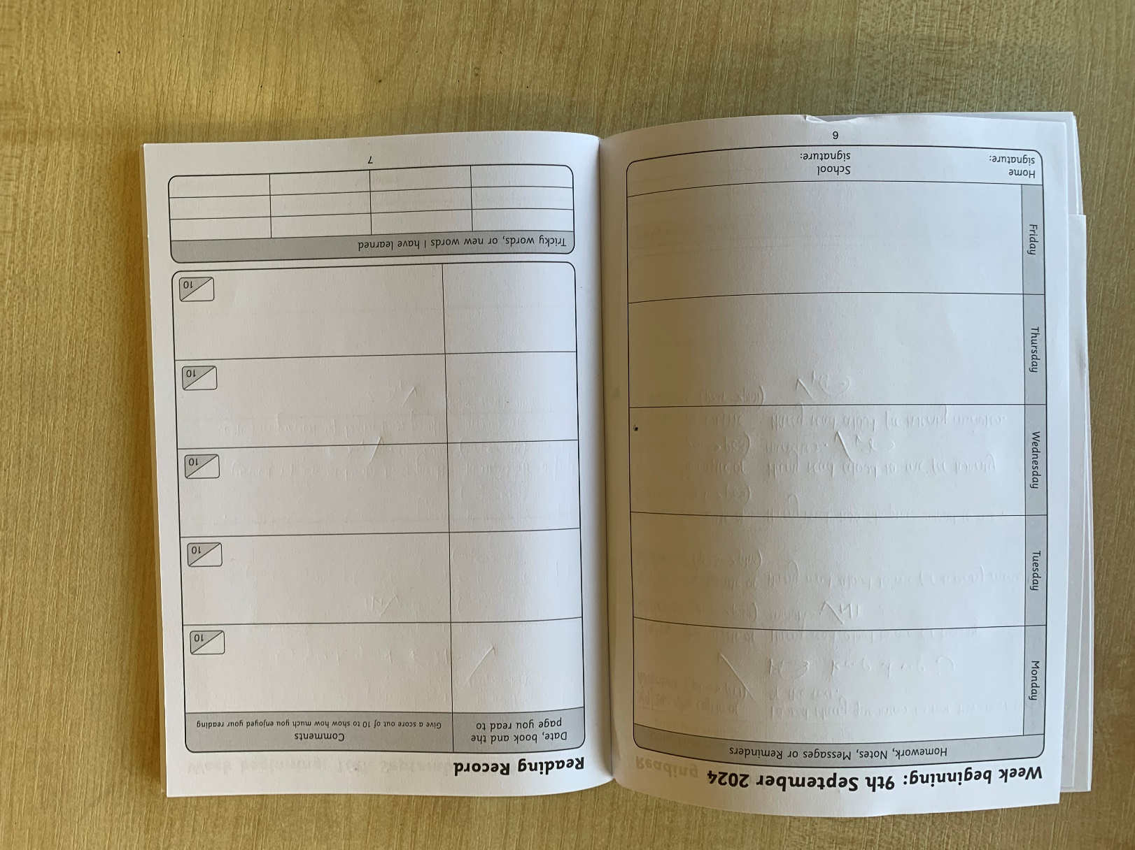

Slide 13
Google Classroom
We will continue to use Google Classroom as a way of setting the homework for the children. Please ask your children to check their Google Classroom.
Contact between school and home should be written or e-mailed separately.

Slide 14
Term time absences
All term time absence requests must go through the office and are reviewed on a case by case basis.
These will only be authorised in exceptional circumstances.
Holidays during term time will not be authorised.

Slide 15
Communication
It is very important that the children feel they can talk to their teachers if they have a worry.
If parents or carers have any concerns, we are happy to call or see you after school when all the children have been collected. The easiest way is to make an appointment is through the school office.

Slide 16
End of Day Procedures
Children in Years 5 are allowed to walk/cycle home alone if you write a permission letter/e-mail to the office.
Separate permission is needed if they are allowed to leave school alone from a club.
It is essential you notify us immediately if your child’s after-school arrangements change .

Slide 17
Wrap around care
Breakfast club from 8am daily - £4
After School club until 5.30pm Monday - Thursday and until 5pm Friday - £10
These must be booked in advance via Scopay. Costs are subject to change.

Slide 18
Key dates for your diary
School Trip to Kew Gardens – 13th October 2025
Science and Computing Week – week commencing 20th October 2025
5D’s class assembly – Friday 14th November 2025
Carol Concert – Thursday 18th December 2025
Parents Evening – week commencing 23rd February 2026
Arts and Culture Week – week commencing 18th May 2026
Arts and Culture Day – 21st May 2026
Sports Week – week commencing 30th June 2026
Sports Day – Friday 3rd July 2026

Slide 19
1:1 sessions

